Slide 1


Team Evolve
ONE-STOP SOLUTION
(AGRIONESTOP)

Slide 2
•The farmers engage in farming and living in villages do not have affordable technology and proper value of their products due to proper reach to the market. Similarly, those who have migrated from the villages, but they have their parental land in village do not have any setup to manage their land and get due reward of that
-> Key Outcomes of this Project:
A Tech-based platform which can provide basic machinery, tools, services etc. at affordable rates need to be developed.
Agriculture management platform is needed to be developed which can have customized solution to non-resident persons to manage their lands.
Problem Statement #2 :Farming is Still a challenge

Slide 3
• Our team, Evolve, has developed a user-friendly software solution to help farmers and small businesses boost their farming productivity.
• Our software provides a comprehensive list of crops suitable for their area and soil type, along with farming techniques to achieve optimal results.
• We prioritize organic and sustainable farming practices, offering safe and effective organic pesticides and fertilizers, and focusing on
->Crop Prediction
-> Crop Harvesting
-> Chaff Cutting and Selling
-> Storing of Crops
-> Fertilizer Details
-> Contact Information of Wholesale buyers
-> Tips for Farming
.• Our solution is designed for all levels of tech-savviness, and we believe it can help farmers increase yields, reduce costs, and improve sustainability.
Proposed Solution

Slide 4

Attention Areas
• Crop Prediction
• Crop Harvesting
• Chaff Cutting and Selling
• Storing of Crops
• Fertilizer Details
• Contact Information of Wholesale buyers
• Tips for Farming

Slide 5
Python(Numpy, Pandas, ScikitLearn, Pickle)
Technology
Used
Machine Learning(RandomForestClassifier)
HTML and CSS
JavaScript
Flask Framework

Slide 6
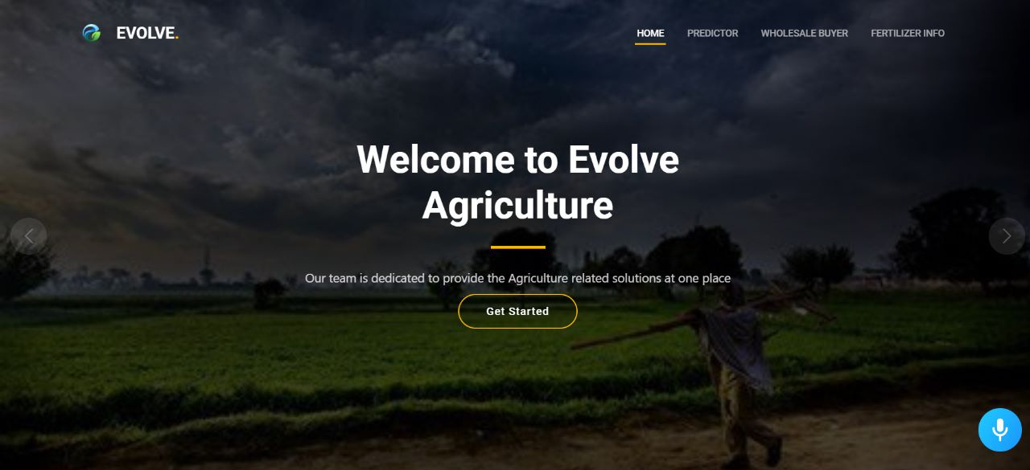
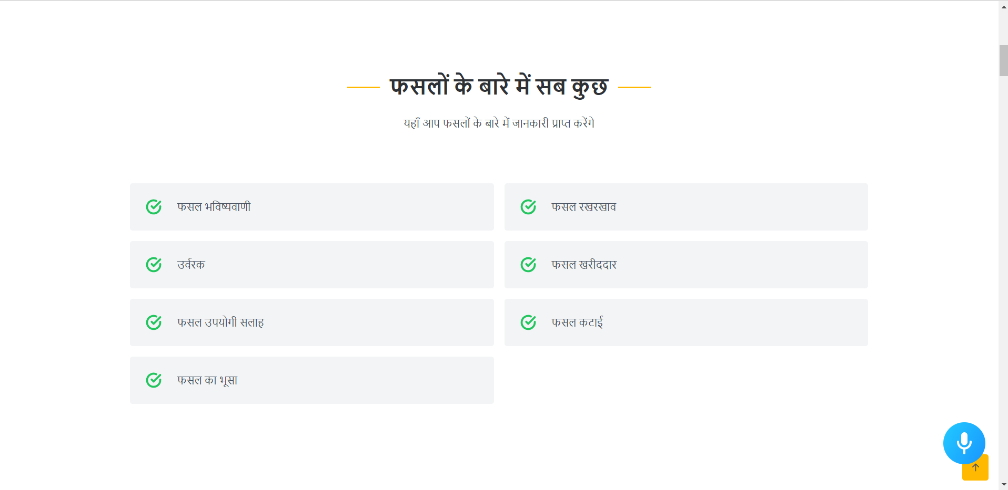
Home Page
The homepage serves as the gateway to all other pages on the website, providing access to data charts and graphs.

Slide 7
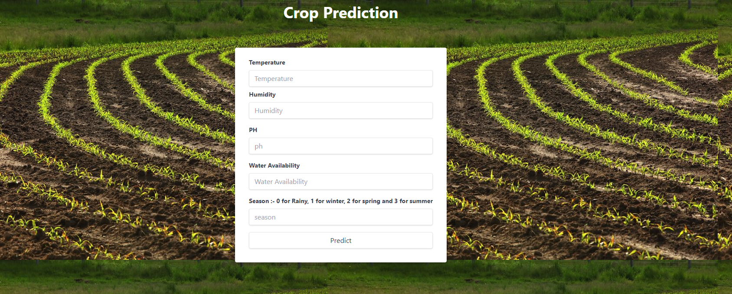
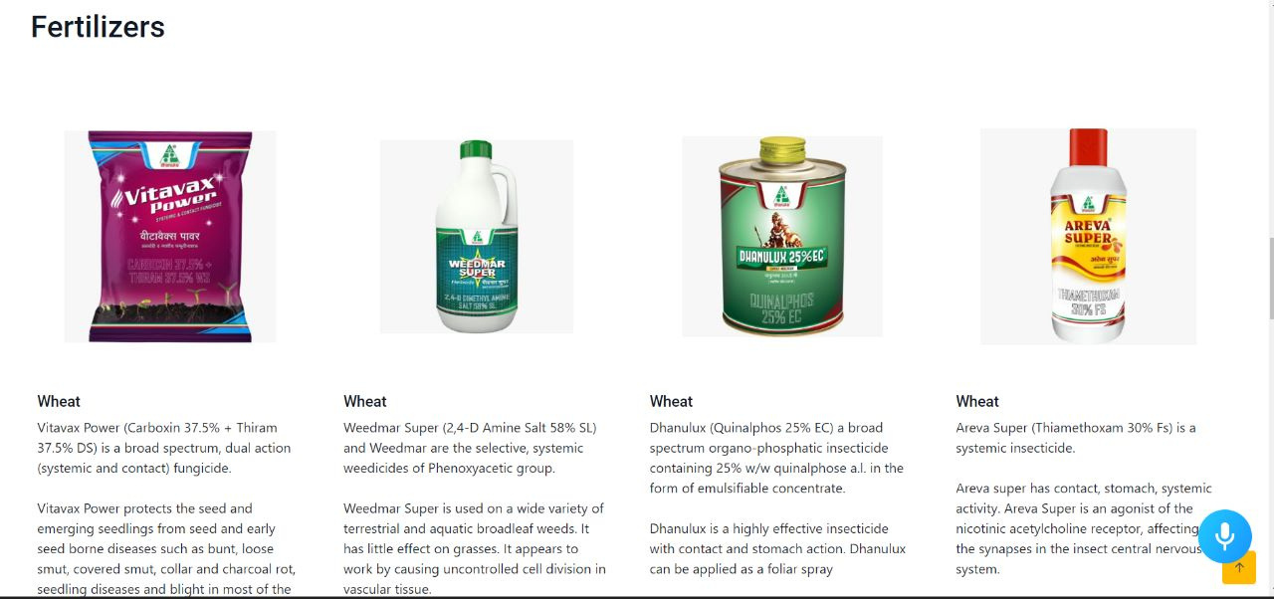
Predictor
On this page, individuals can view a comprehensive list of fertilizers necessary for crops and fields.

Slide 8
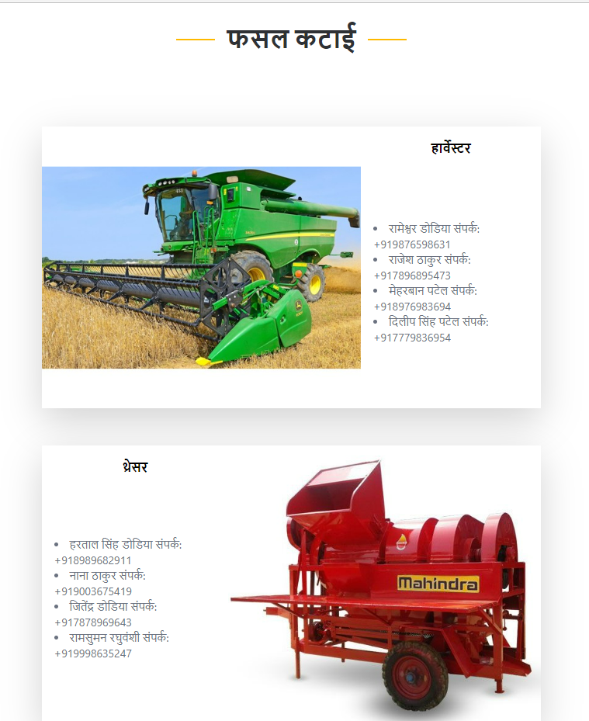
Crop Harvesting
On this page, individuals can view a comprehensive list of available dealers for harvesting crops.

Slide 9
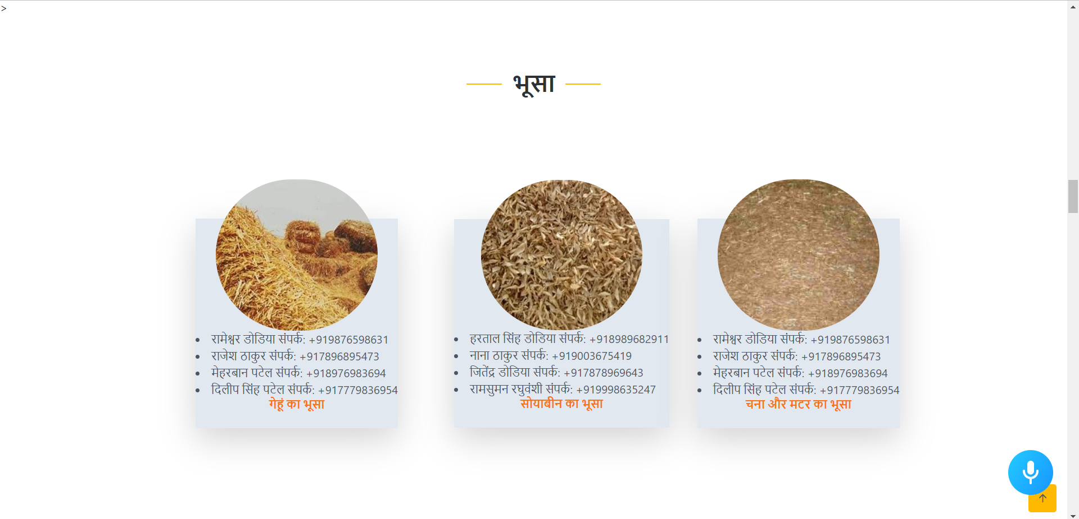
Chaff Cutting and Selling
On this page, individuals can view a comprehensive list of all the Chaff cutters and Seller/buyers available with contact details.

Slide 10
Fertilizers
On this page, individuals can view a comprehensive list of fertilizers necessary for crops and fields.

Slide 11
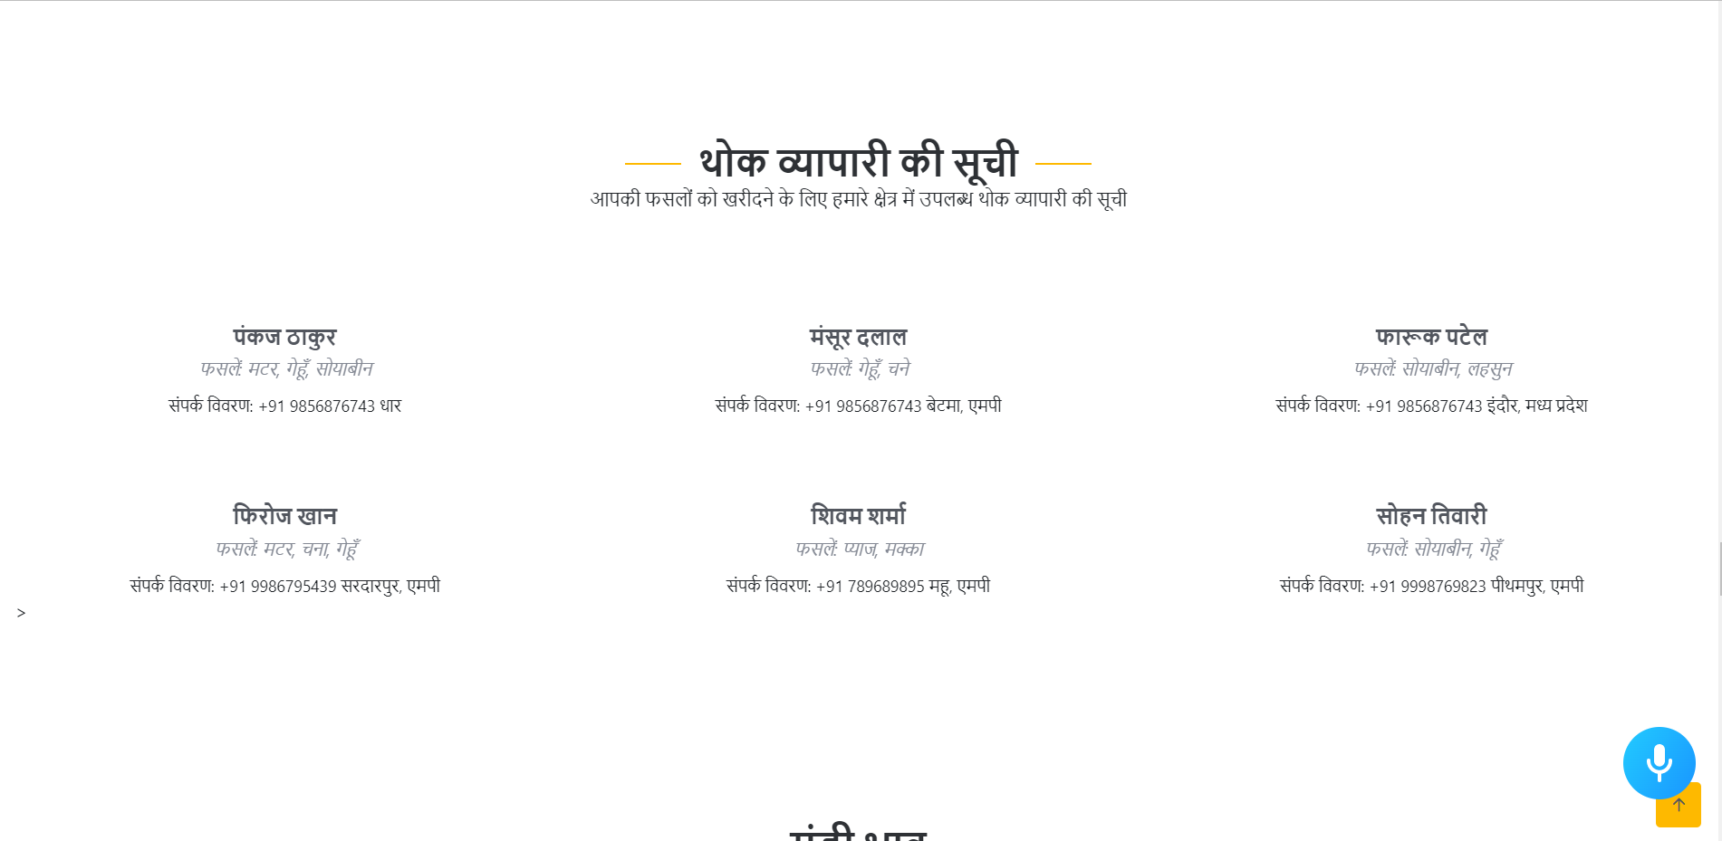
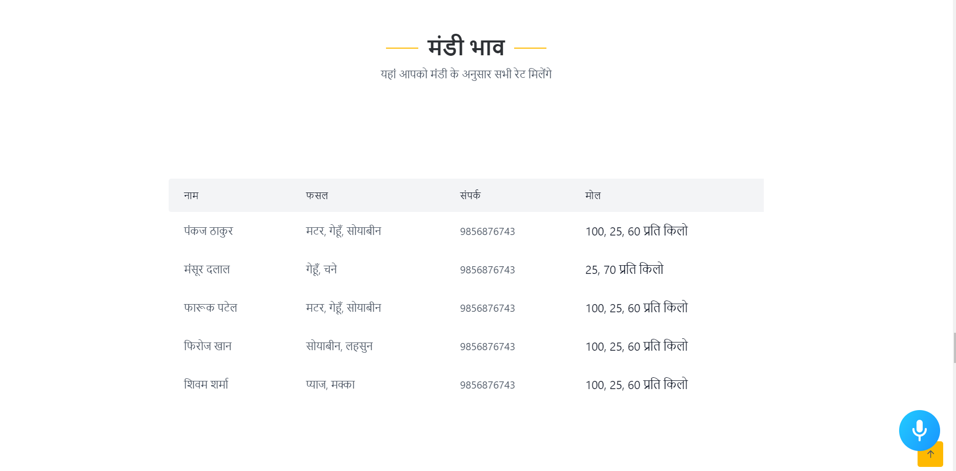
Wholesalers
This webpage displays all the available crop buyers and the updated Mandi Rates.

Slide 12
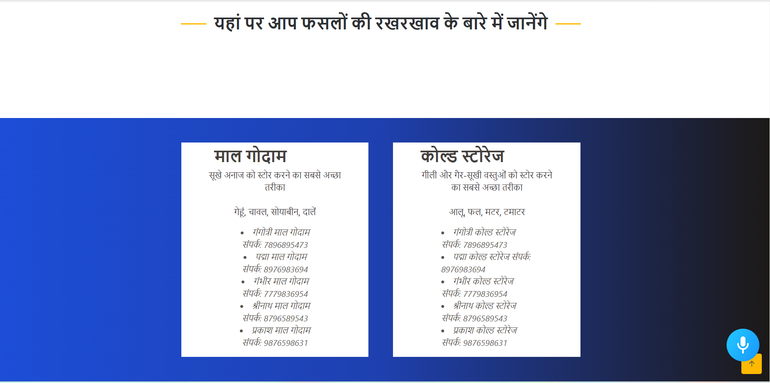
Storing of Crops
This webpage displays all the possible storage facilities that are necessary for crops in one convenient location.

Slide 13
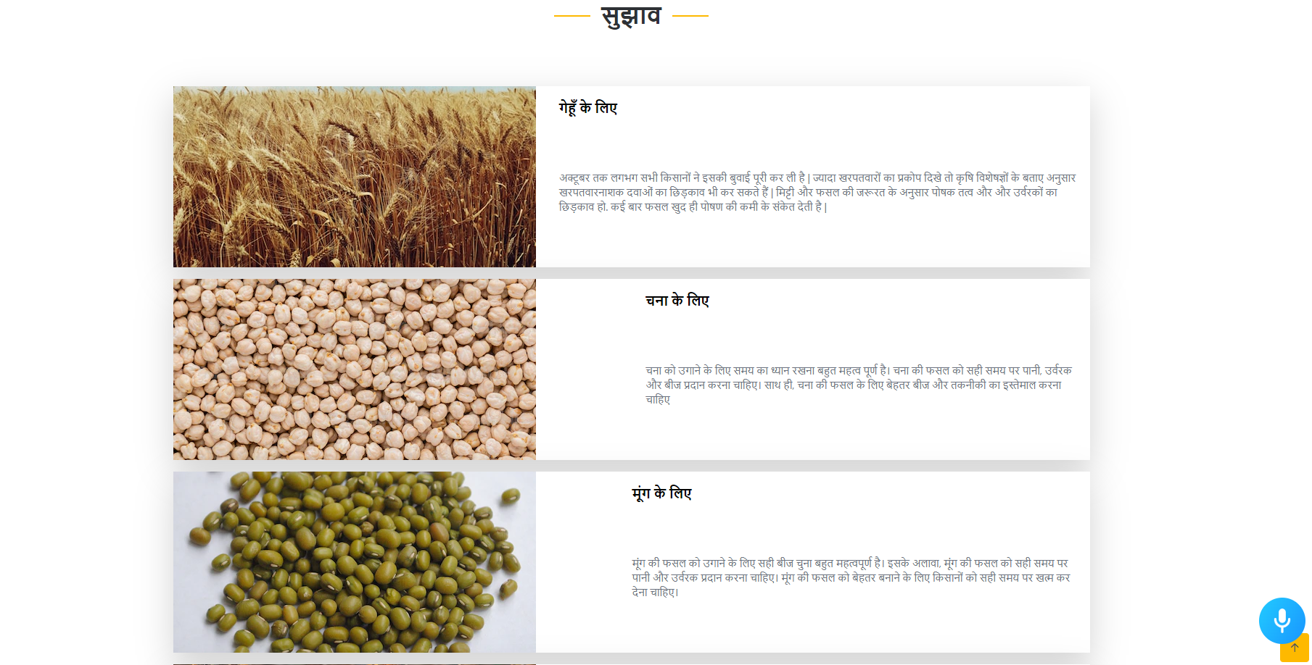
Tips for Farming
This webpage displays the Additional tips for the farmers to do the farming practices in a much better way.

Slide 14
Team EVOLVE
Anurag Mukati
Chinmay Pathak
Divyansh Rai
Rishabh Rathore

Slide 15
Thank You
Team Evolve

